Slide 1
BVBot
Sem-II Mini Project
Akanksha Anil Jagtap
B(20)

Slide 2
Existing System
The current college support system typically comprises a combination of manual processes and digital resources.
Students are primarily rely on in-person interactions with advisors, faculty, and administrative staff to address their queries and concerns.
This involves visiting various offices on campus or scheduling appointments via email or phone.
Limitations such as: Limited Accessibility, Response Time, Administrative Burden, etc.

Slide 3
Proposed System
BVBot is an intelligent chatbot solution .
Revolutionize the college support system .
Providing instant assistance, streamlining administrative workflows, and enhancing the overall student experience.
conversational interface.
Understands natural language queries.
Navigates college systems, website and delivers personalized responses to user in real-time.

Slide 4
Technologies Used
React.js ➔ open-source JavaScript library .It is widely used for building user interfaces, especially for single-page applications where the user interacts with the page without reloading it.
Rasa Framework ➔ provides a framework for developing AI chatbots that uses natural language understanding (NLU). • It allows the user to train the model and add custom actions.
CSS ➔ CSS3 For styling and layout design and for component-level styling

Slide 5
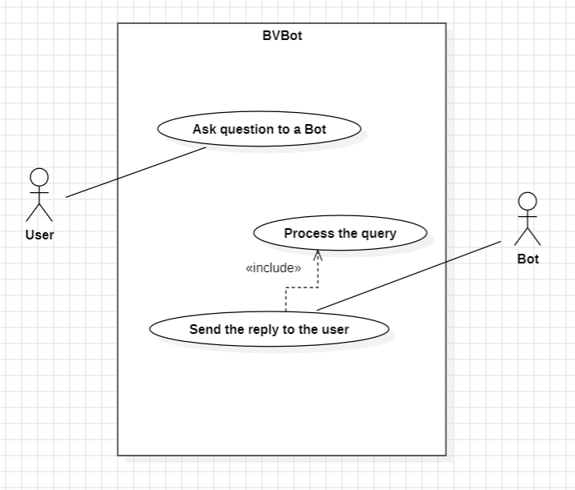
Use Case

Slide 6
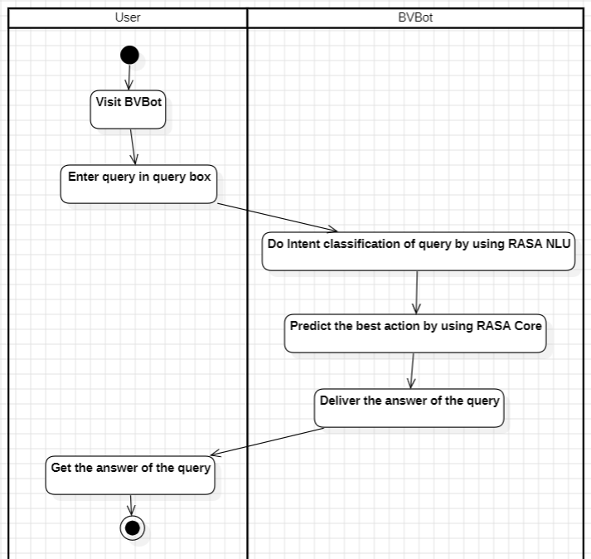
Activity Diagram

Slide 7
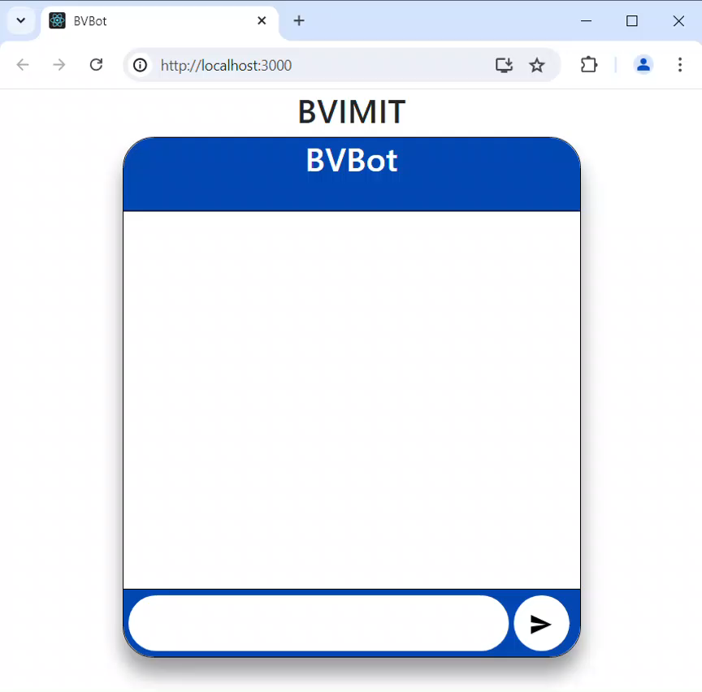
DEMO

Slide 8
SaMPLE questions for the bot
Can you give me information about BVIMIT?
What courses are available at BVIMIT?
How can I apply to BVIMIT?
What is the fee Structure?
List of important documents required for the admission
I need the contact details for the admissions office.
Can I get the list of faculty members of BVIMIT?
Can I get placement information?
Can I get this year's academic calendar for BVIMIT?

Slide 9
THANK YOU..!

